Slide 1

RFM SEGMENTATION ANALYSIS PROJECT
M.K.SUGANTHE RAMYA

Slide 2
Agenda
Product Overview
Understanding the data
EDA
Univariate, Bivariate and Multivariate Analysis
Data Visualization
Data Preparation
Data Processing
Data Cleaning
RFM segmentation
Relevant Data Assembly
Setting up RFM Scales
Score Designation
Segment Classification
Personalization of strategies for relevant segments
Business insights
Customer behavior analysis
Insights for better sales

Slide 3
EDA Summary of the dataset
This Dataset contains sales data of automobiles across countries. Agenda of this project is Customer segmentation using RFM.
EDA is analyzed in tableau Public Software and Summary of the data ,RFM Segmentation is analyzed using Jupyter Notebook (Python)
Given Dataset Contains 19 columns and 2747 rows
There are no null values and duplicates
There are Outliers But not treated for RFM Segmentation
Status Column has 6 unique values where as Productline has 7 Unique values and Deal Size has 3 unique values
Most of the data is left skewed
Priceeach and Sales Columns are highly correlated, MSRP and Priceeach are also positively high correlated

Slide 4
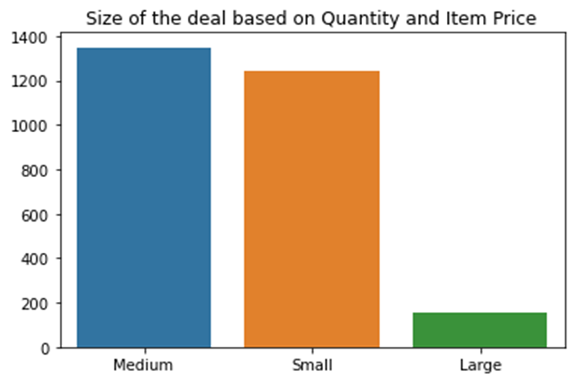
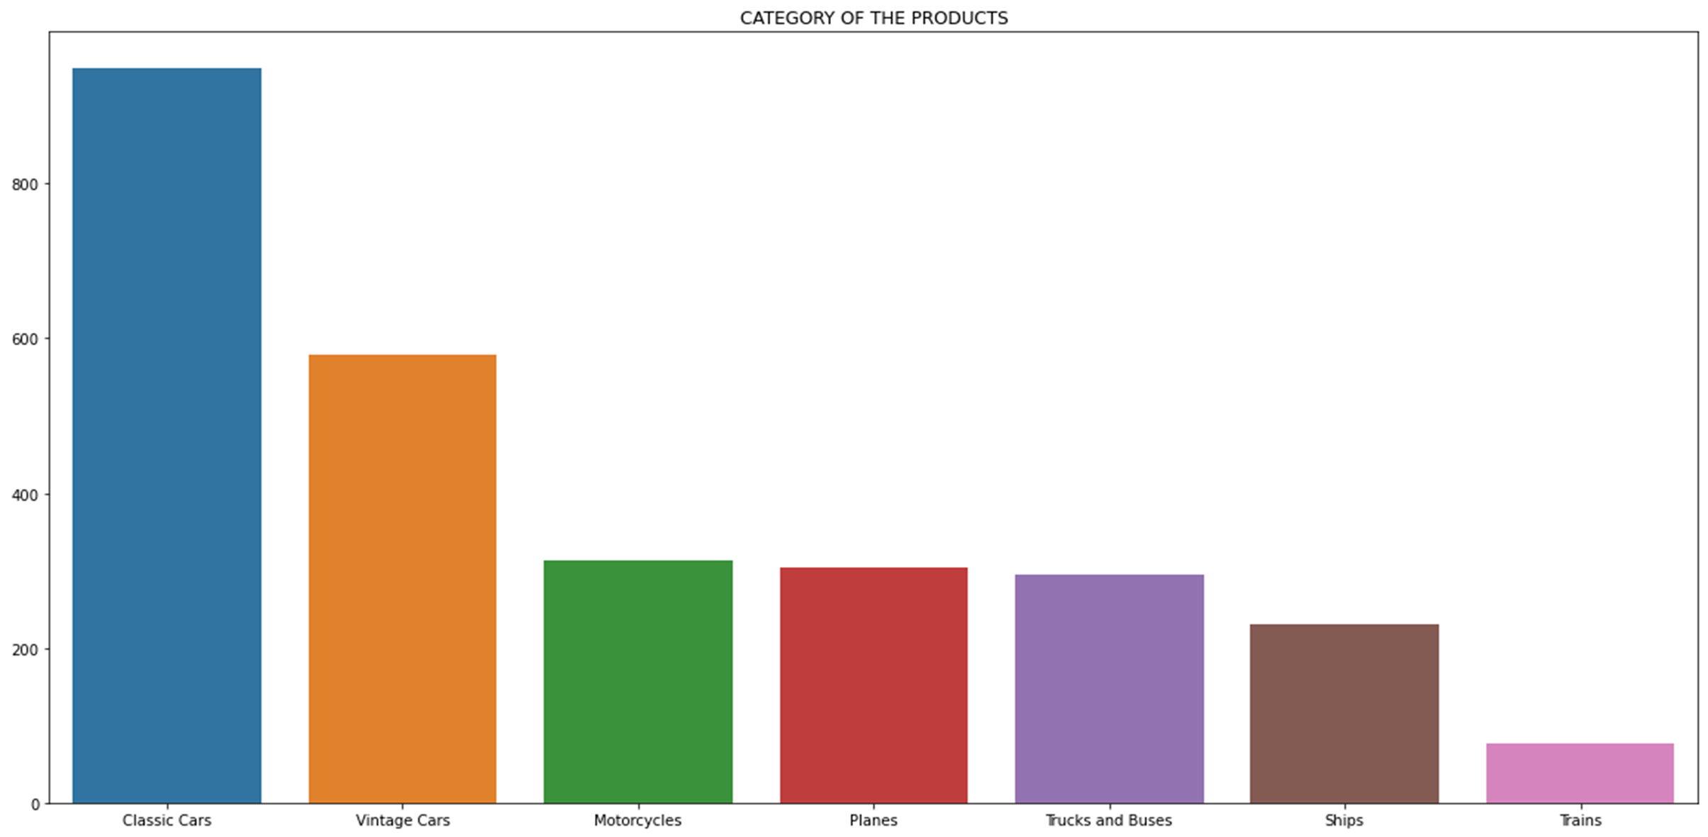
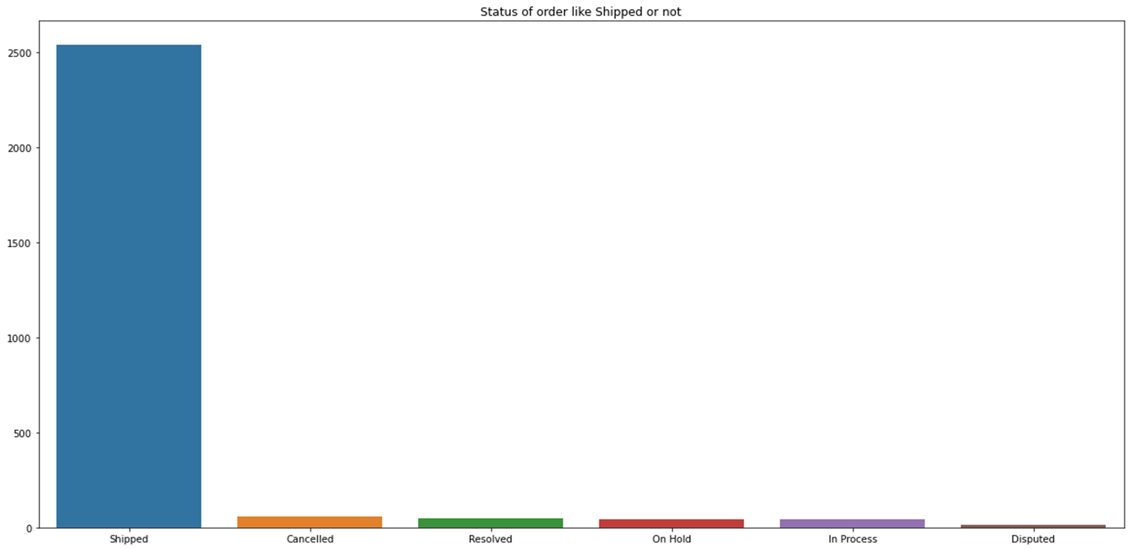
Univariate Analysis
Most of the customer preferred more on medium deal
Larger deal size is very low compared to Medium and Small
Classic cars are highest selling product followed by Vintage cars
Least selling product is Trains
Most of the product are shipped on time

Slide 5
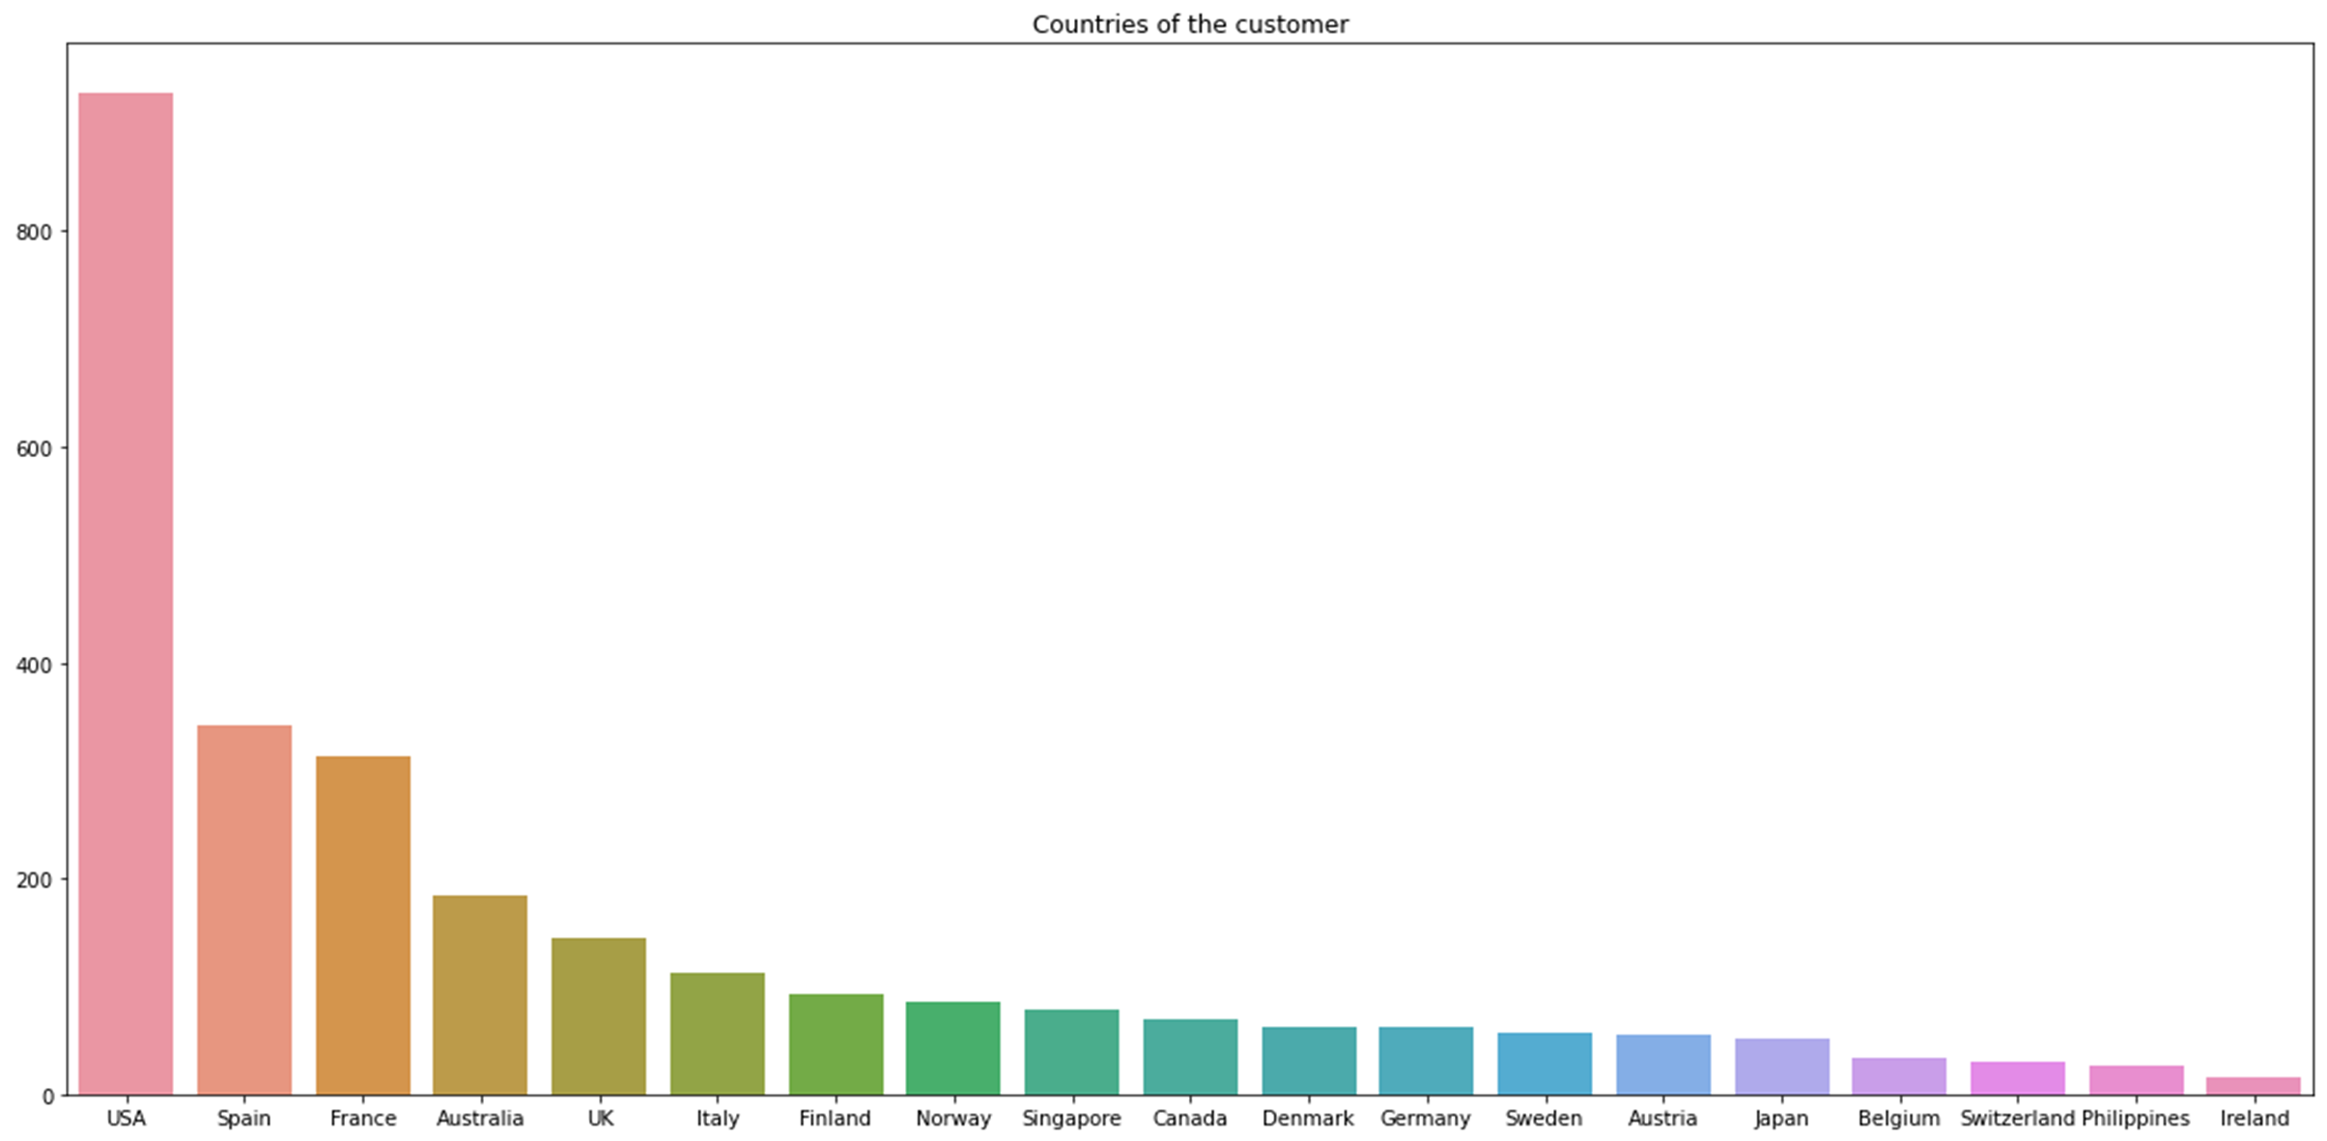
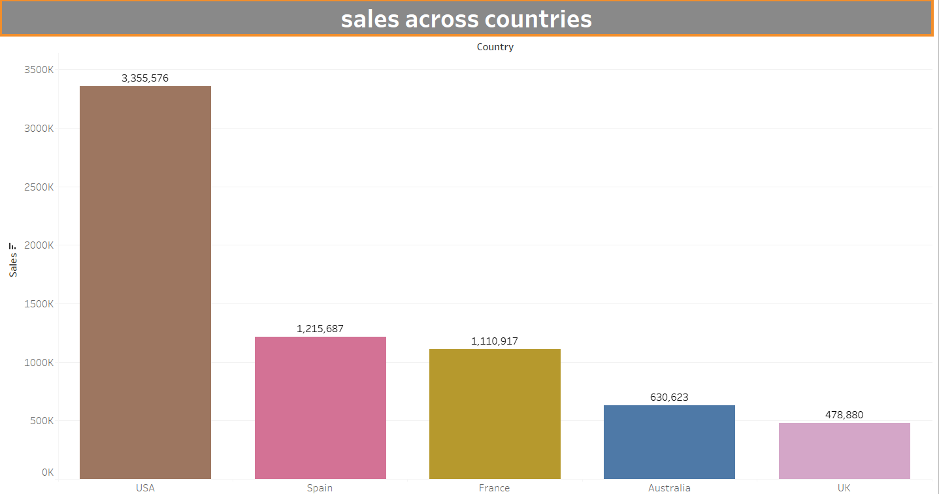
Sales across countries
Countries of the customers
USA has highest no of customers
Second highest customers from Spain
Ireland have very low customers
Sales across countries
Top 5 highest countries-USA, Spain, France, Australia, UK
USA has highest sales
Spain, France countries have moderate amount of sales

Slide 6
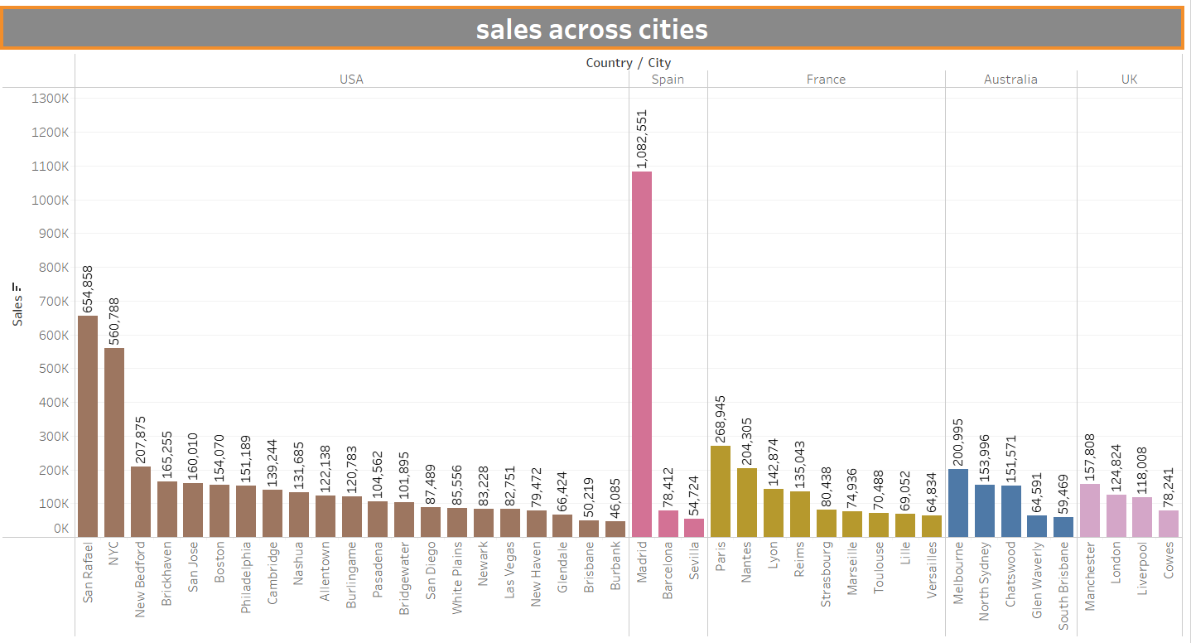
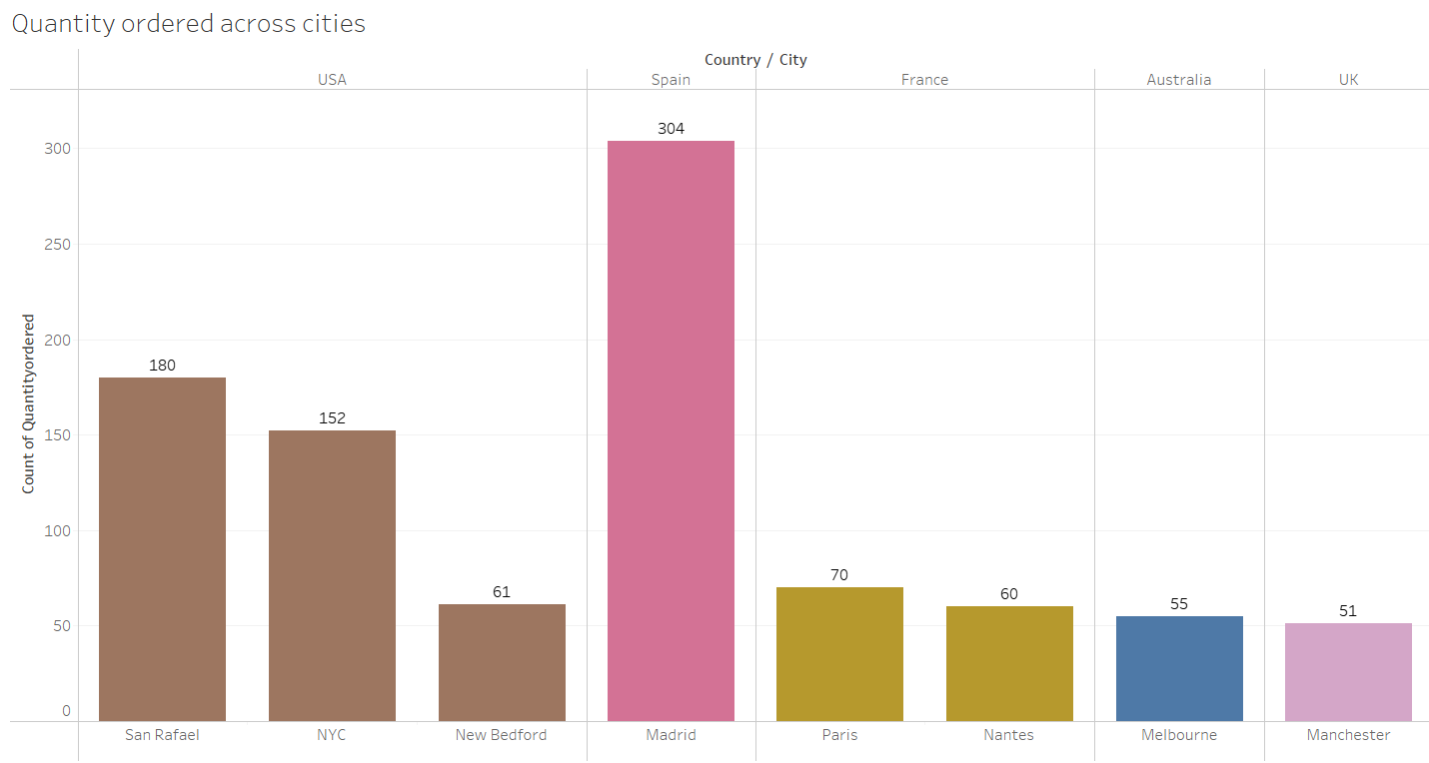
Sales across cities
Sales across cities
In Spain, Madrid have highest sales and lowest sales is from Sevilla
In USA ,San Rafael has highest sales , Second highest sales from NYC
Madrid have sales more than 1000K
San Rafael have sales more than 600K
Quantity ordered across cities
Madrid have ordered 304 quantities of the products
San Rafael ordered 152 quantities of the products

Slide 7
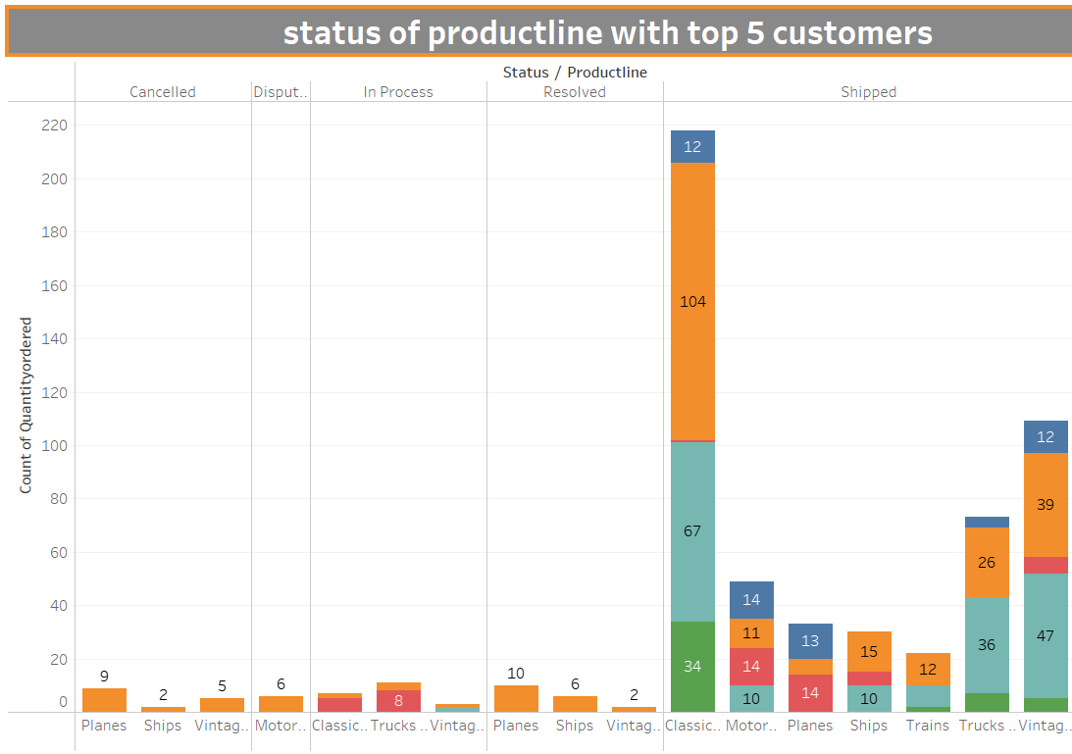
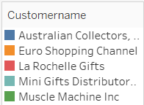
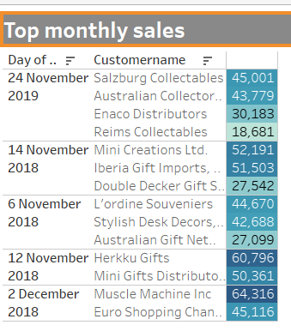
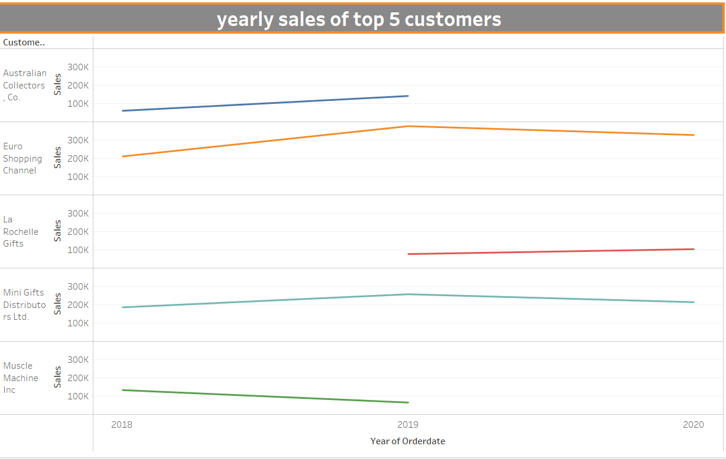
Top 5 customers
Top 5 Customers
Top 5 customers mostly bought classic cars followed by vintage cars
Most of the products are shipped on time
Highest sales are in the month of November and December
Euro shopping Chanel and Mini Gifts distributors are loyal customers

Slide 8
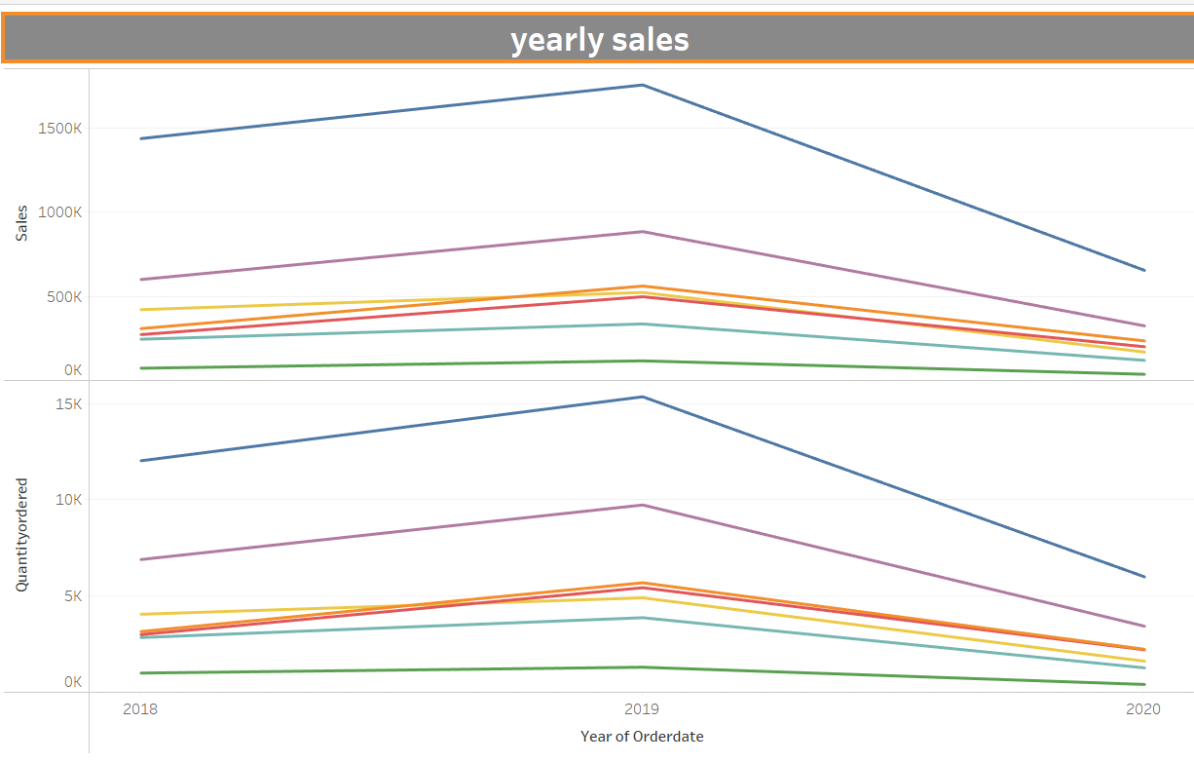
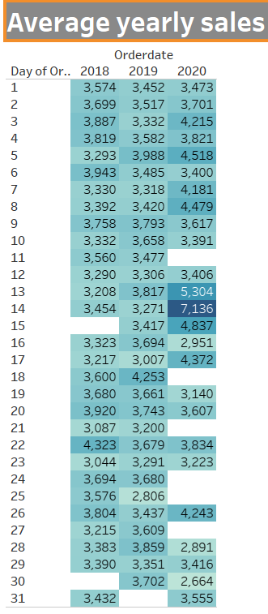
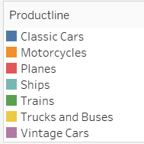
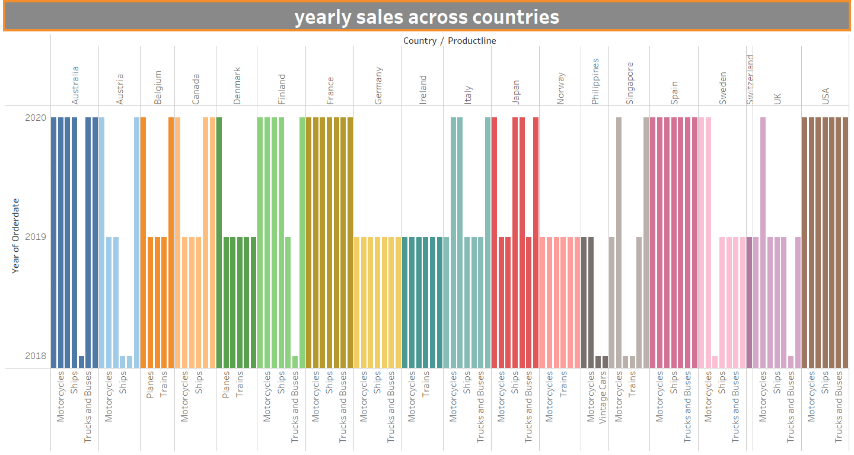
Yearly sales Trends
Yearly sales Analysis
Increasing trend seen between 2018 - 2019
Decreasing trend between 2019 – 2020
Trains are least bought by customers
Classic Sales have higher sales and ordered in higher quantity
Second highest sales is Vintage cars
Average sales increased in the year 2020 in the mid of each month
Customers stopped ordering planes ,Trains from most of the countries
Customers from USA, Spain and France ordered products from 2018 -2019

Slide 9
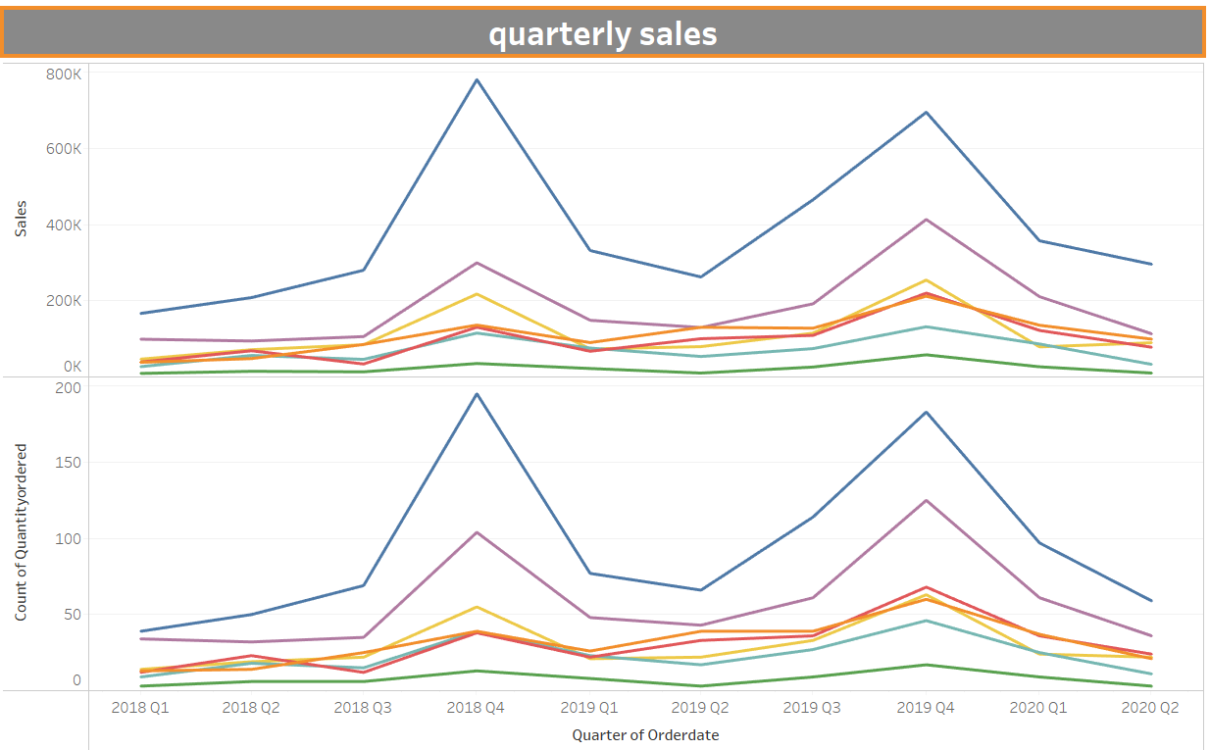
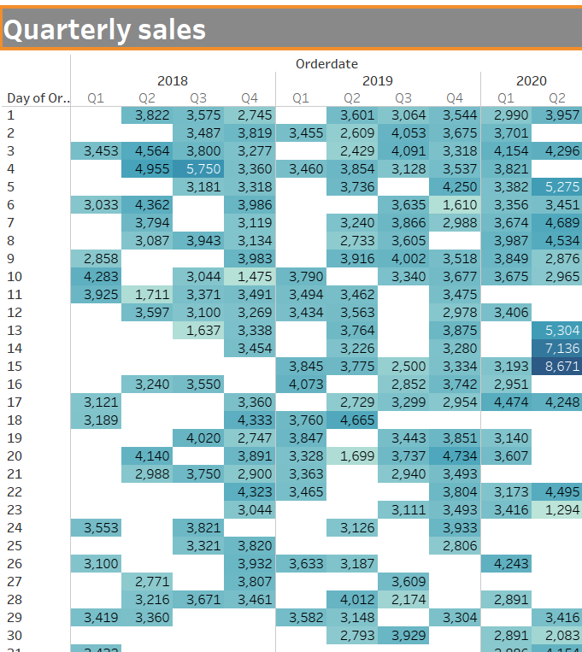
Quarterly sales Trends
Quarterly sales Analysis
Increasing sales trend pattern in Quarterly Average sales
Average Sales are peak in the fourth quarter
Average Sales are very low in first Quarter
Average Sales are start to rise Third Quarter
Customers bought more Classic Cars

Slide 10
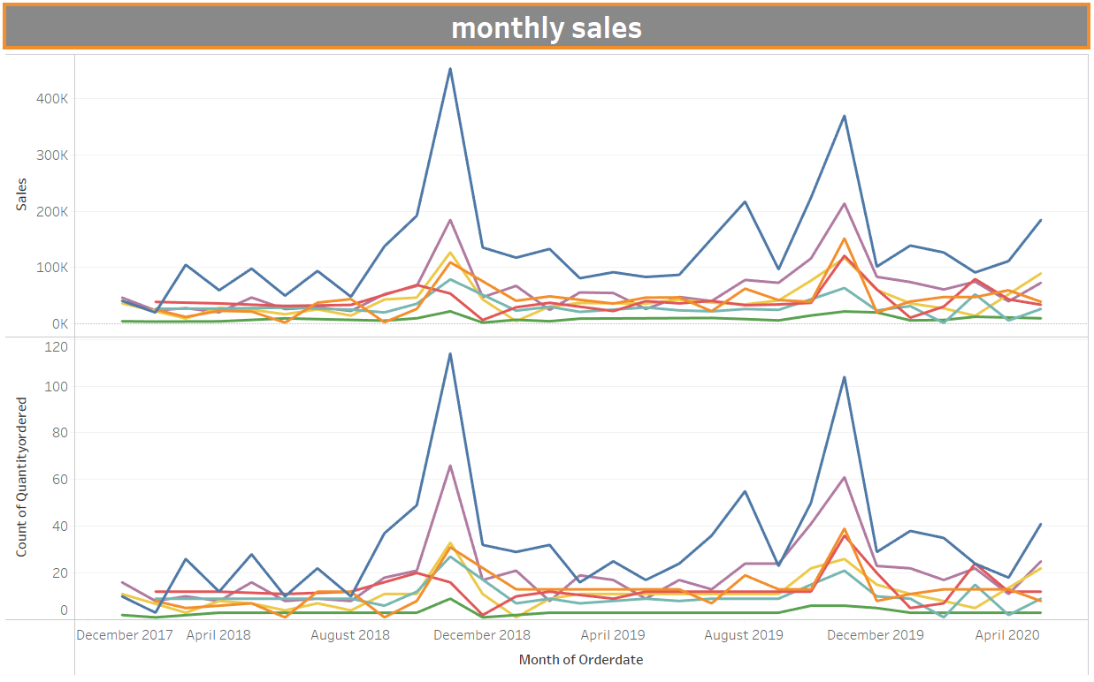
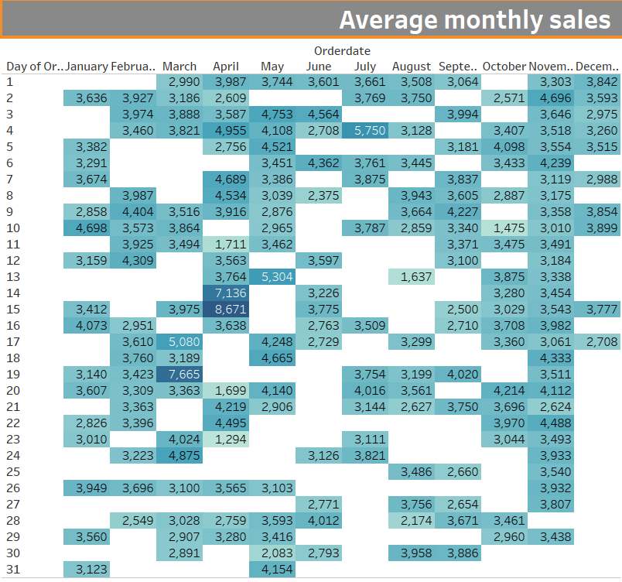
monthly sales Trends
monthly sales Analysis
Seasonality is observed in monthly sales
Average Monthly Sales are peak in the month of November
Average Monthly Sales are very low in the month of June, July, August
Average Sales are start to rise from the month of September

Slide 11
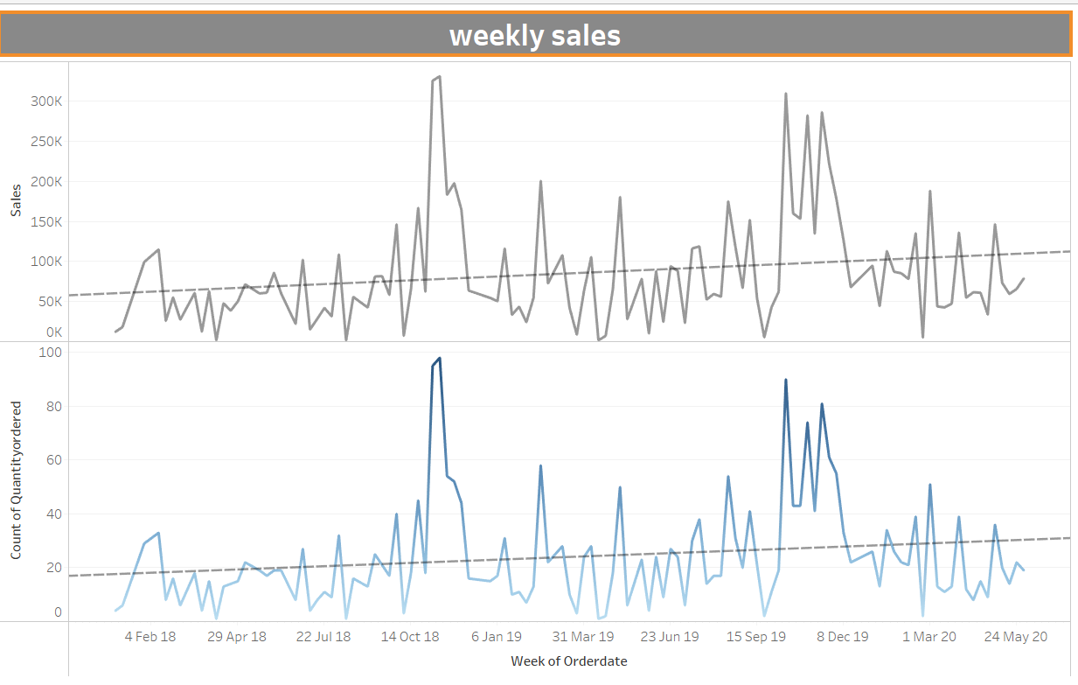
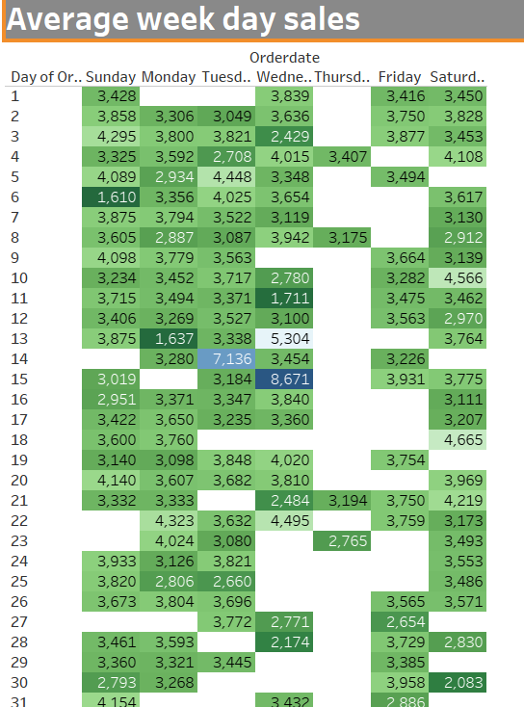
weekly sales Trends
monthly sales Analysis
Seasonality is observed in weekly sales
Slightly increasing trend is observed
Average weekly Sales are peak on Monday
Average weekly Sales are very low on Thursday

Slide 12
RFM Segmentation
RFM segmentation is done in Jupyter Notebook using Python Language
For RFM analysis, we need only three columns. 'CUSTOMERNAME', 'ORDERNUMBER', 'ORDERDATE' and 'SALES’
RFM stands for Recency, Frequency, and Monetary value, each corresponding to some key customer trait.
It analyzes customers' behavior on three parameters: Recency: How recent is the last purchase of the customer. Frequency: How often the customer makes a purchase. Monetary: How much money does the customer spends.
Methodology
To get the RFM score of a customer, we need to first calculate the R, F and M scores on a scale from 1 (worst) to 4 (best).
calculate Recency = number of days since last purchase
calculate Frequency = number of purchases during the studied period (usually one year)
calculate Monetary = total amount of purchases made during the studied period
find quintiles for each of these dimensions
give a grade to each dimension depending in which quintiles it stands
combine R, F and M scores to get the RFM score
map RF scores to segments
Calculate the Recency ,Frequency and Monetary Values

Slide 13
RFM scores
Calculated table of the R, F and M scores
Derived RFM score of each customer based on each parameter based on rank within the parameter
R_Quartile :
when compared to all customers, recency is best for customer 3 as he is ranked as number 1, whereas for frequency he is in 4th position, and in terms of the value he is in 2nd position.
F_Quartile:
Customer count will be split into 4 equal parts to rank the customers on a scale of 1 to 4 where 4 being the most frequent.
M_Quartile:
Tagging customers in the range of 1 to 5 based on their Total price value, where 5 corresponds the customers having highest monetary value
Finally combine scores of RFM Into RFM Class/RFM Score
RFM Class:
R_Quartile+ F_Quartile+ M_Quartile

Slide 14
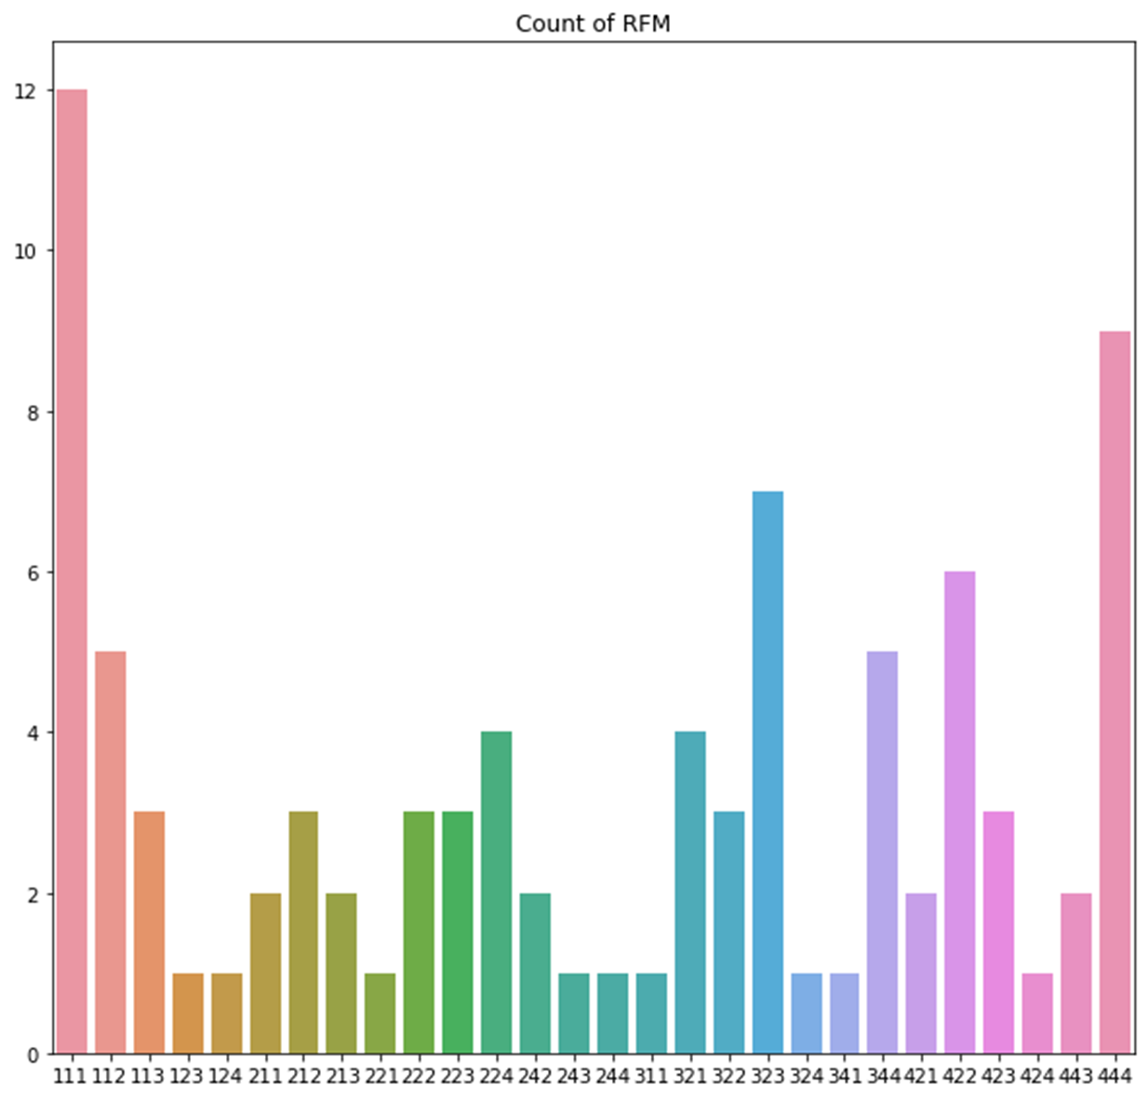
RFM segmentation
RFM segmentation
RFM score gives us 4³= 64 segments which are not easy to work with
For this analysis, Data is segmentation into 4 segments
Best Customers
Bought recently, buy often and spend the most
Churning Customers
Used to purchase frequently but haven’t returned for a long time.
Lost Customers
Below average recency and frequency. Will lose them if not reactivated.
Loyal Customers
Buy on a regular basis. Responsive to promotions.

Slide 15
Who are the best customers?
Top 5 Best Customers
best customers, who bought most recently, most often, and are heavy spenders.
Reward these customers.
They can become early adopters for new products
They will help promote your brand.

Slide 16
Which customers are on the verge of churning?
verge of churning Customers
Churning Customers who purchased often and spent big amounts but haven’t purchased recently. These customer at risk customers may soon churn out
Send them personalized reactivation campaigns to reconnect
offer renewals
helpful products to encourage another purchase

Slide 17
Who are loyal customers
Loyal Customers
Buy on a regular basis. Recent customers with average frequency and who spent a good amount.
Offer membership
loyalty programs recommend related products to upsell them
it will help them become your Loyalists or best customers

Slide 18
Who are lost customers
Lost Customers
Customers failing the recency criterion only are those customers who have stopped visiting
Business should focus on these customers and look out for the reason why they abandoned
Bring them back with relevant promotions
run surveys to find out what went wrong and avoid losing them to a competitor.

Slide 19
Business insights
Toys are no longer just for children. As adults buy into the collectible and memorabilia.
Mostly customers have gift shops, Vintage shops, memorabilia shops or Souvenirs shops
Automobiles toys such as Classic cars, Vintage cars, planes , Trucks, motorcycles, buses and ships
Classic cars are mostly bought by the customers followed by the Vintage cars
USA is main market to sell theses automobiles toys .Customers from USA bought the classic cars and Vintage cars
Most of the best customers are from USA ,Spain and France .Try to increase Best customers .During the month of November offer them festive offer to these customers. They will increase the revenue and bring new Customers. Whenever new product is launched ,design special promotions offers for these customers. They will help to promote the business
Loyal Customers are mainly USA, Spain, France and Australia . Introduce membership programs where they can have offers for festive seasons and special days
Churning Customers are mainly UK, Italy France. Do Survey to know there are not visiting recently. Bring them back with relevant promotions and try to offer discount price for previously bought products
Lost Customers are mainly from the France , Ireland, Germany, USA and Spain. USA ,Spain ,France bring huge revenue find the reasons why they left. Understand the problem and solve it. This will help the verge of churning customers to stay in business

Slide 20
conclusion
RFM is a data-driven customer segmentation technique that allows marketers to take tactical decisions.
It empowers marketers to quickly identify and segment users into homogenous groups and target them with differentiated and personalized marketing strategies.
It offers many advantages such as its universal application in various areas (finance, marketing, sales) as well as its adaptability and flexibility.
Also, RFM marketing is, by its nature, an historical method: it looks at past customer behavior that may or may not accurately indicate future activities, preferences and responses.
More advanced customer segmentation techniques are based on predictive analytics technologies that tend to be far more accurate at predicting future customer behavior.

